Slide 1


Faculty of Computing and Informatics
Business Management Information Systems –BMC511S
Lesson 2 – Global Business and Collaboration

Slide 2
Faculty of Computing and Informatics
Business Processes
Business processes
  Flows of material, information, knowledge
  Sets of activities, steps
  May be tied to functional area or be cross-functional
Businesses: Can be seen as collection of business processes
Business processes may be assets or liabilitiess

Slide 3
Faculty of Computing and Informatics
Business Processes
Examples of functional business processes
  Manufacturing and production
    Assembling the product
  Sales and marketing
    Identifying customers
  Finance and accounting
    Creating financial statements
  Human resources
    Hiring employees

Slide 4
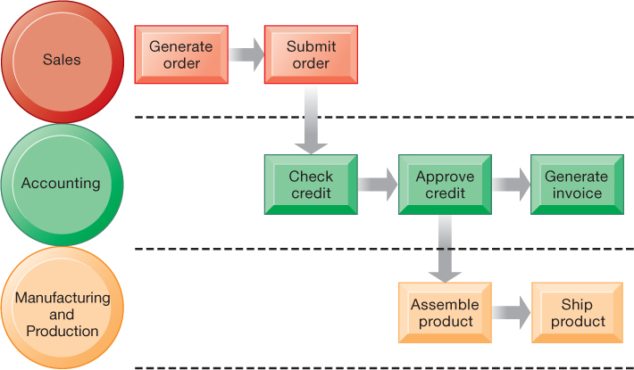
Faculty of Computing and Informatics
Figure 2.1 The Order Fulfillment Process

Slide 5
Faculty of Computing and Informatics
How Information Technology Improves Business Processes
Increasing efficiency of existing processes
  Automating steps that were manual
Enabling entirely new processes
  Changing flow of information
  Replacing sequential steps with parallel steps
  Eliminating delays in decision making
  Supporting new business models

Slide 6
Faculty of Computing and Informatics
Transaction processing systems
  Serve operational managers and staff
  Perform and record daily routine transactions necessary to conduct business
    Examples: sales order entry, payroll, shipping
  Allow managers to monitor status of operations and relations with external environment
  Serve predefined, structured goals and decision making

Slide 7
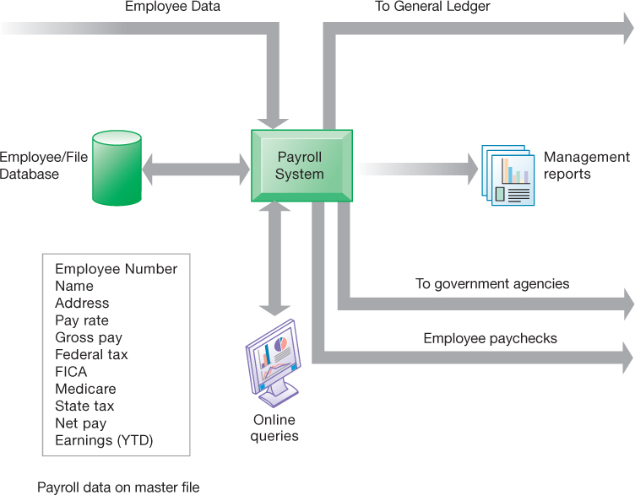
Faculty of Computing and Informatics
Figure 2.2 A Payroll T P S

Slide 8
Faculty of Computing and Informatics
Management Information Systems
Serve middle management
Provide reports on firm’s current performance, based on data from T P S
Provide answers to routine questions with predefined procedure for answering them
Typically have little analytic capability

Slide 9
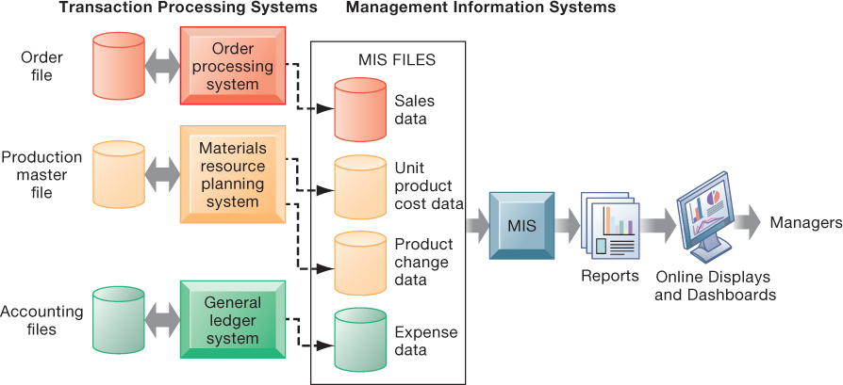
Figure 2.3 How Management Information Systems Obtain Their Data from the Organization’s T P S

Slide 10
Decision Support Systems
Serve middle management
Support nonroutine decision making
  Example: What is the impact on production schedule if December sales doubled?
May use external information as well T P S / M I S data
Model driven D S S
  Voyage-estimating systems
Data driven D S S
  Intrawest’s marketing analysis systems

Slide 11
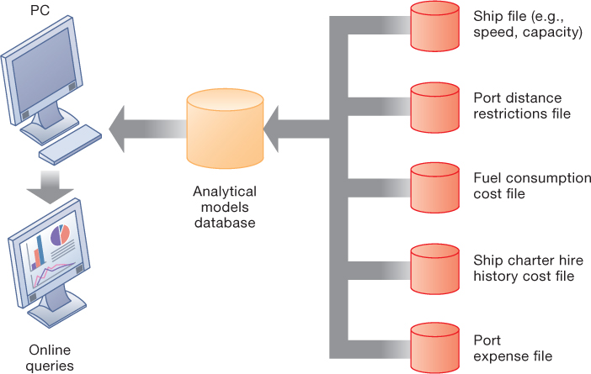
Figure 2.5 Voyage-Estimating Decision-Support System

Slide 12
Executive Support Systems
Support senior management
Address nonroutine decisions
  Requiring judgment, evaluation, and insight
Incorporate data about external events (e.g., new tax laws or competitors) as well as summarized information from internal M I S and D S S
Example: Digital dashboard with real-time view of firm’s financial performance

Slide 13
Enterprise Applications
Systems for linking the enterprise
Span functional areas
Execute business processes across the firm
Include all levels of management
Four major applications
  Enterprise systems
  Supply chain management systems
  Customer relationship management systems
  Knowledge management systems

Slide 14
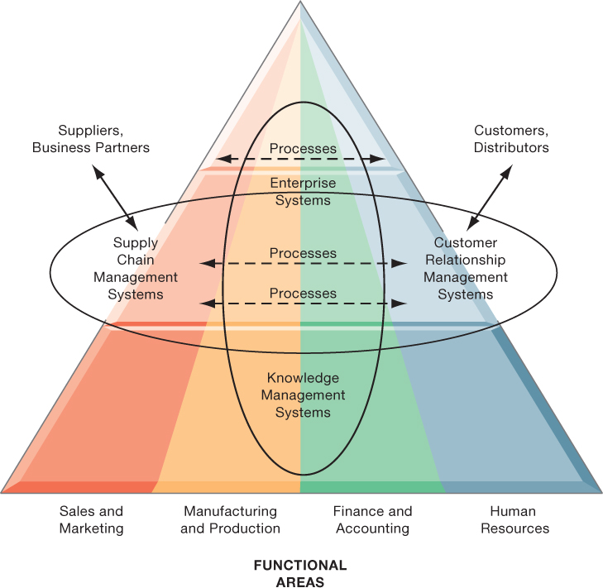
Figure 2.6 Enterprise Application Architecture

Slide 15
Enterprise Systems
Collect data from different firm functions and store data in single central data repository
Resolve problems of fragmented data
Enable:
  Coordination of daily activities
  Efficient response to customer orders (production, inventory)
  Decision making by managers about daily operations and longer-term planning

Slide 16
Supply Chain Management (S C M) Systems
Manage firm’s relationships with suppliers
Share information about:
  Orders, production, inventory levels, delivery of products and services
Goal:
  Right amount of products to destination with least amount of time and lowest cost

Slide 17
What is Collaboration?
Collaboration
  Short lived or long term
  Informal or formal (teams)
Growing importance of collaboration
  Changing nature of work – more interaction between employees, customers,suppliers
  Growth of professional work—“interaction jobs, professionals”
  Changing organization of the firm – flattened no more hierarchical
  Changing scope of the firm –globalization – but close coordination
  Emphasis on innovation – comes more from team work
  Changing culture of work – diverse teams better than individuals

Slide 18
Tools and Technologies for Collaboration and Social Business
E-mail and instant messaging (I M)
Wikis
Virtual worlds .e.g. meetings on Teams
Collaboration and social business platforms
  Virtual meeting systems (telepresence)
  Cloud collaboration services (Google Drive, Google Docs, etc.)
  Microsoft SharePoint and I B M Notes
  Enterprise social networking tools

Slide 19
Business Benefits of Collaboration and Teamwork
Investments in collaboration technology can bring organization improvements, returning high R O I
Benefits
  Productivity
  Quality
  Innovation
  Customer service
  Financial performance
    Profitability, sales, sales growth

Slide 20
The Information Systems Department
Often headed by chief information officer (C I O)
  Other senior positions include chief security officer (C S O), chief knowledge officer (C K O), chief privacy officer (C P O), chief data officer (C D O)
Programmers
Systems analysts
Information systems managers
End users

Slide 21
Organizing the Information Systems Function
I T governance
  Strategies and policies for using I T in the organization
  Decision rights
  Accountability
  Organization of information systems function
    Centralized, decentralized, and so on

Slide 22
Thank you

